Slide 1

Product Management Module 2 – Office Hrs with Raunak Goyal Oct 15, 2023

Slide 2
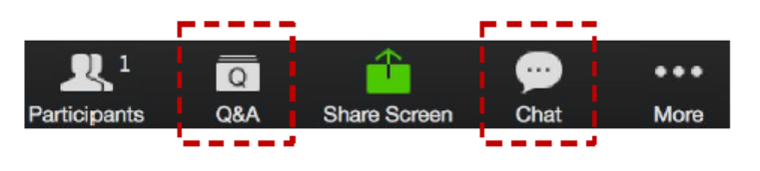
ZOOM: CHAT and Q&A BOX
Please enter your questions in the Q&A box. We’ll answer these in the Q&A and stop from time to time to bring these to the broader attention of the class
Please enter your response in the ‘Chat box.’ Before you send it, please make sure that your response goes to ‘All Panelists and Attendees’
Please type your questions in the QA
Also, ongoing discussion in the Chat
Notes:
Please enter your questions in the Q&A box. We’ll answer these in the Q&A and stop from time to time to bring these to the broader attention of the class
Please enter your response in the ‘Chat box.’ Before you send it, please make sure that your response goes to ‘All Panelists and Attendees’
Due to the size of the cohort we will not be able to unmute people to speak, though we may investigate doing that in later sessions.
Now for today’s agenda

Slide 3



AGENDA
Getting Help
Queries & Feedback
Expectation Setting
Module Review
Assignment Discussions
Additional Resources
Programme Schedule
Next Week
Q&A
Notes:
In today’s session we will cover the following topics:
Getting Help
Module Review
Assignment Discussions
Additional Resources
Programme Schedule
Next Week
Q&A

Slide 4
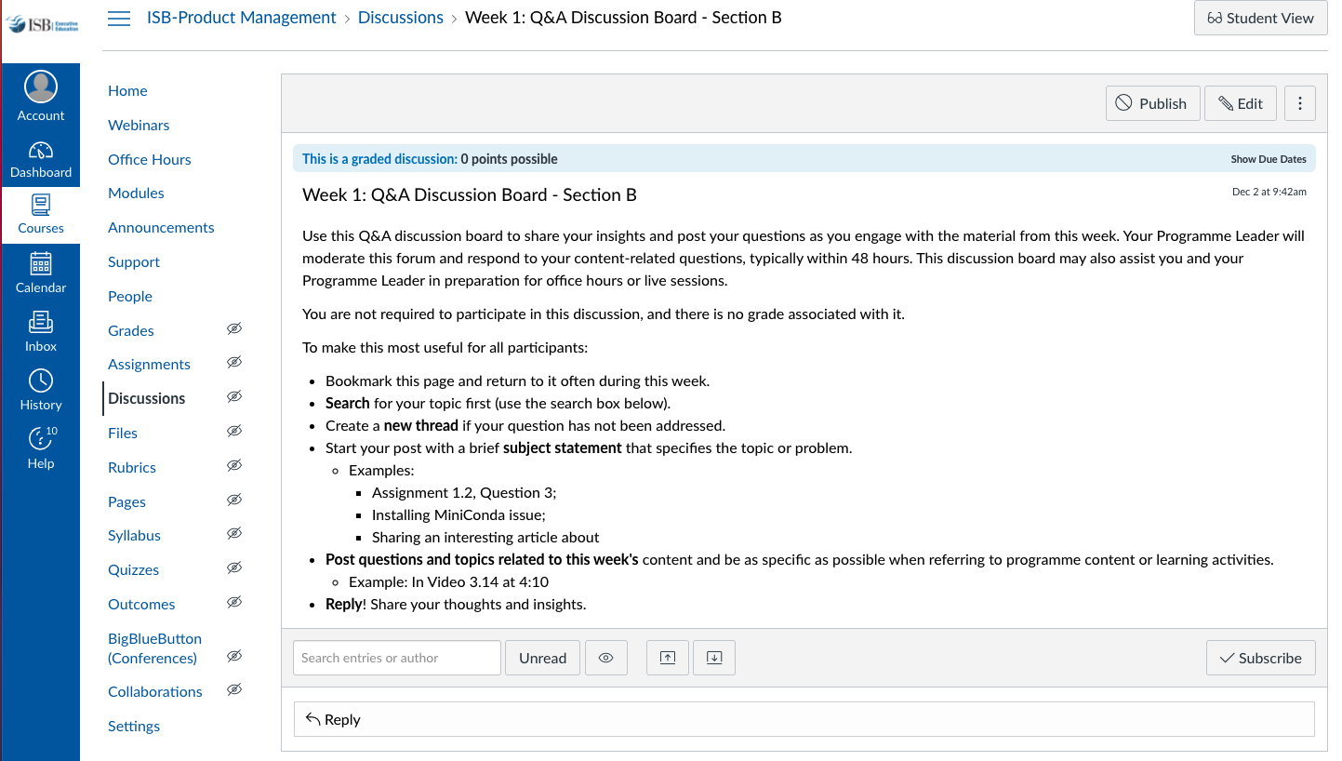
GETTING HELP
Notes:
One of the best resources are your classmates. A great way to learn from them is to engage on the weekly discussion topic. We want to broadly encourage collaboration, though without plagiarism. Share your thoughts, concepts, pluses and minuses though not your actual answers.
These are accessible in the weekly module, though I have highlighted the page where you will be taken.
It is great that many of you are setting up study groups via WhatsApp. We encourage that independent initiative and effort, while the programme leaders can not participate in those groups, we will engage in the group discussions on Canvas. What we will also do is provide some of the additional resources we reference in office hours in these discussions.

Slide 5
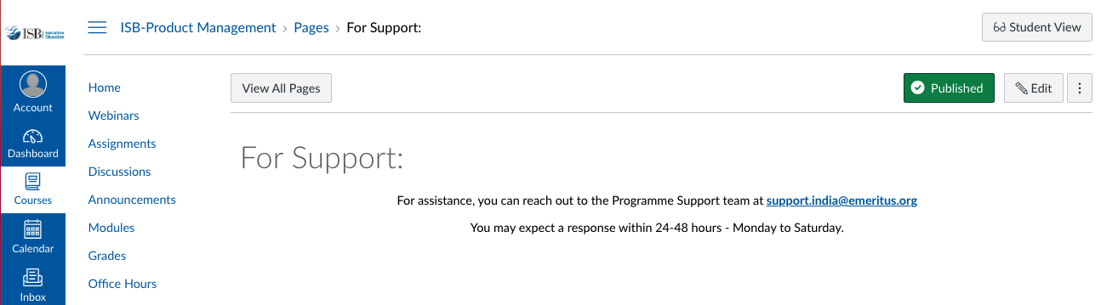
GETTING HELP
Notes:
And for content or assignment related material CLICK
You can reach out to your programme leader via an Inbox email for help. CLICK
Then for support for Canvas and other technical items contact support. This generally includes grading and associated scheduling and requests. When you click the Support tab it takes you to this page. Note that you are asked to send an email to programme.support@eruditus.com. For those of you who may not be in India, note the spelling of program.

Slide 6
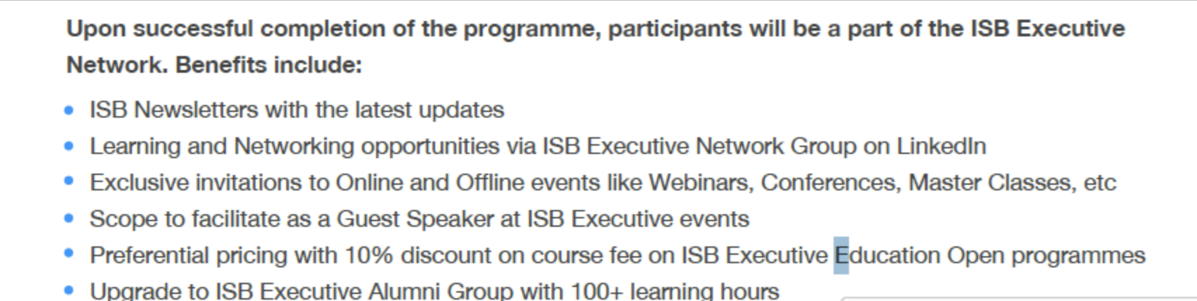
Query 1: ISB Alumni Status?
Here is a screenshot of the benefits they will receive upon completion of the course.

Slide 7
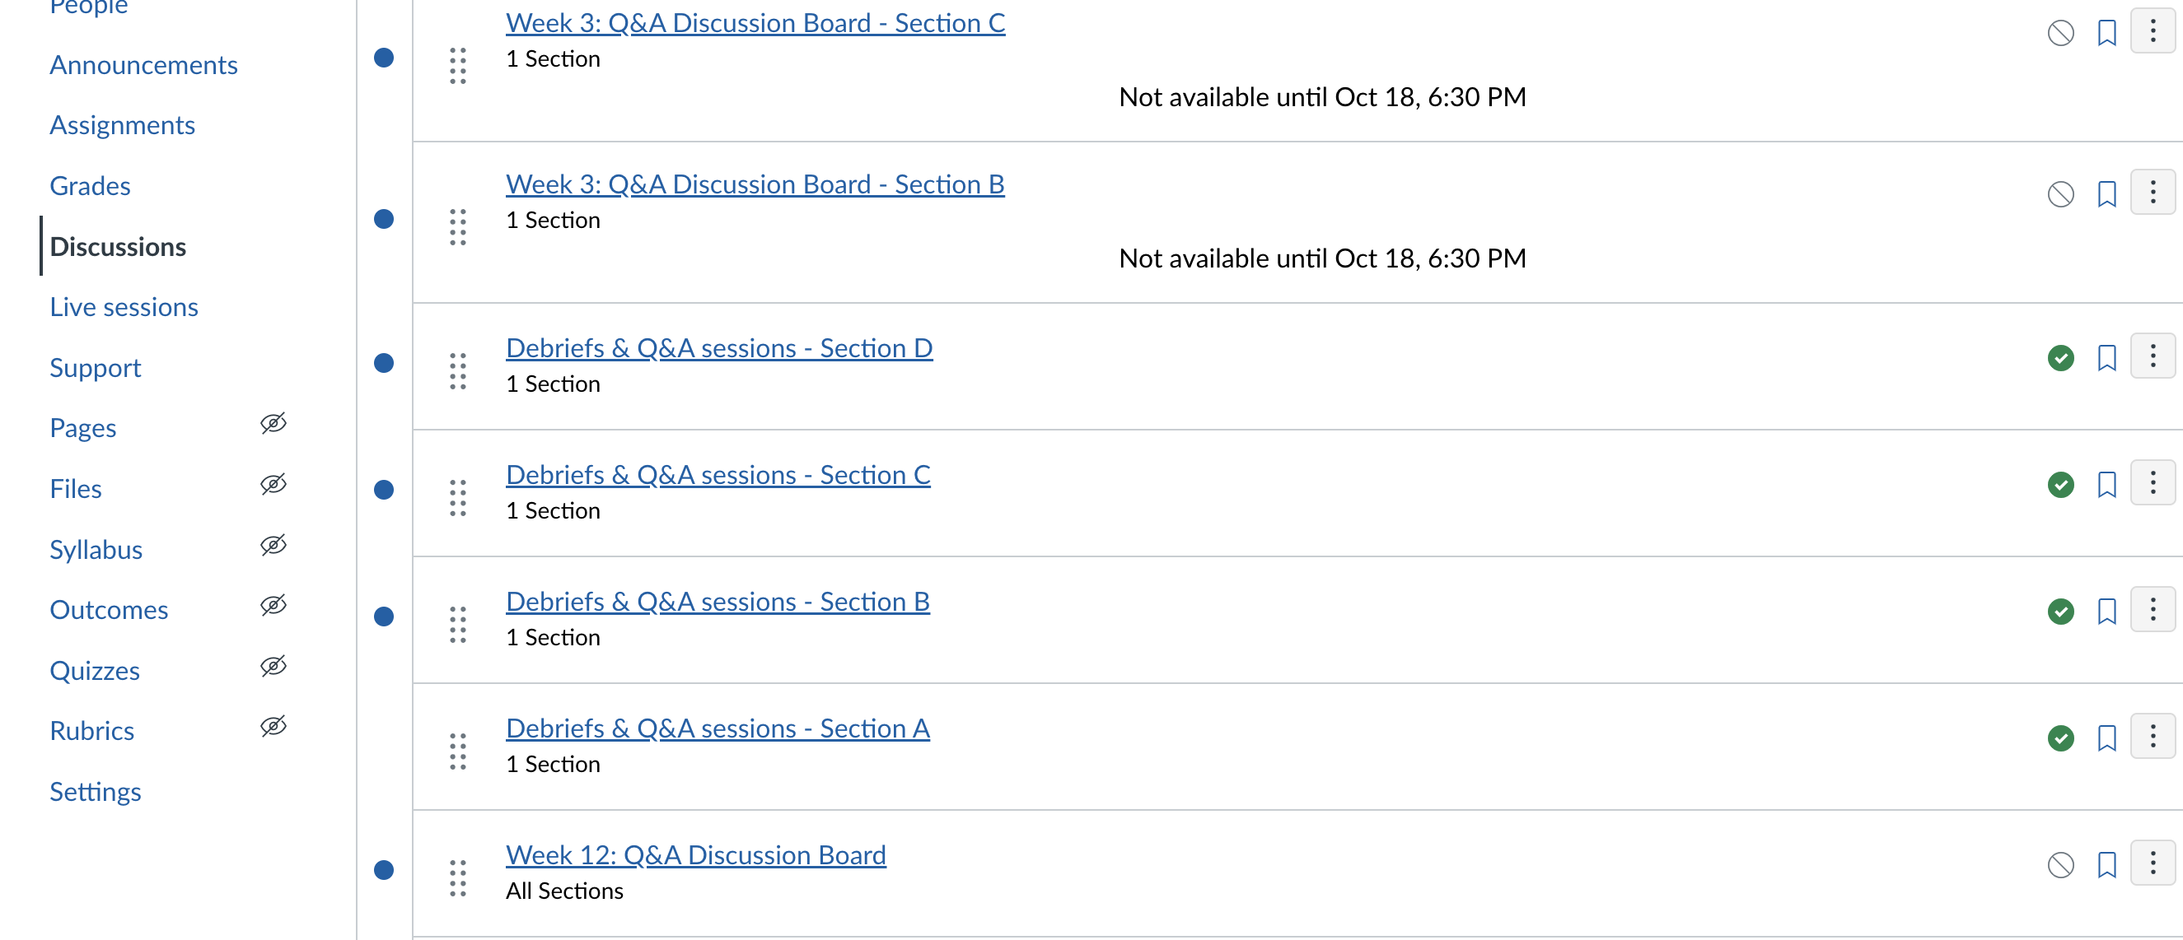
Query 2: Schedule for Assignment & Debrief Session
The assignment debrief session schedule will appear under the "Discussion Board" tab, and we can't reserve time slots in your calendar because it's divided into sections.

Slide 8
Query 3: Case Study/Industry Sessions?
An announcement will be rolled out shortly, and these sessions will be conducted by external speakers, not by the Programme Leads.

Slide 9
Query 4: Career Services
Career services will be offered to the participants towards the 2nd half of the course. For more details, please write to the program support.

Slide 10
Expectation/Objective from Office Hrs
Simplify the key ideas from the video lectures for better understanding.
Offer supplementary resources and readings for those who want to dive deeper.
Clarify the expectations and guidelines for the week's assignments.

Slide 11
What Office Hrs is Not?
Please note that office hours are primarily not for Q&A due to the large cohort size, but some questions may be addressed if they are relevant to ongoing discussions.
Office hours are not intended for in-depth assignment discussions.
We have specific debriefing sessions for each section to address these two purposes.

Slide 12
Feedbacks from last session
Timing of the session should be in the morning
The topic of office hours is the same as what is covered in the video lectures
Many questions were not answered
More discussion on Assignments
Too many questions break the flow of the session
More examples need to be discussed

Slide 13
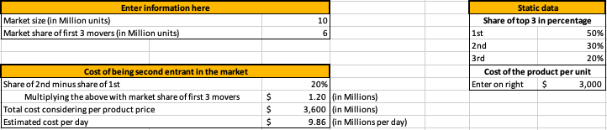
WEEK 1 ASSIGNMENT REVIEW
Notes:
Let’s do a quick review of assignment 1.2 from last week.
Here is the solution, though I will call out a few things we discussed last week as we go through it. CLICK
There was an unmentioned market share assumption for the first 3 entrants of 60%. You can see the result of that assumption in the first box which shows the market share of the first 3 entrants to be 6M units of the total of 10M.
CLICK
Also, a cost of $3000 is provided without a reference to the contribution margin of the product. A better label for this item would be “unit price” or “cost to customer” to help differentiate it from certain internal costs.
CLICK
This results in the calculation in the third section of $9.86M/day. Note it says “Estimated cost per day”, which in this case means lost revenue revenue per day.

Slide 14
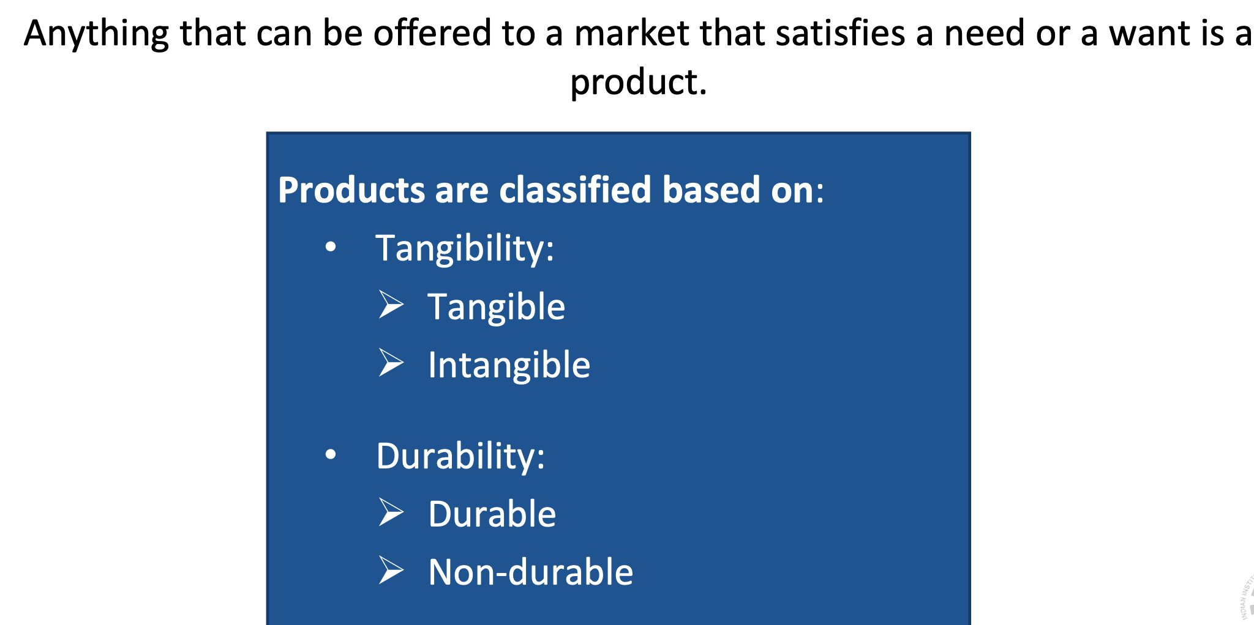
What is Product?

Slide 15
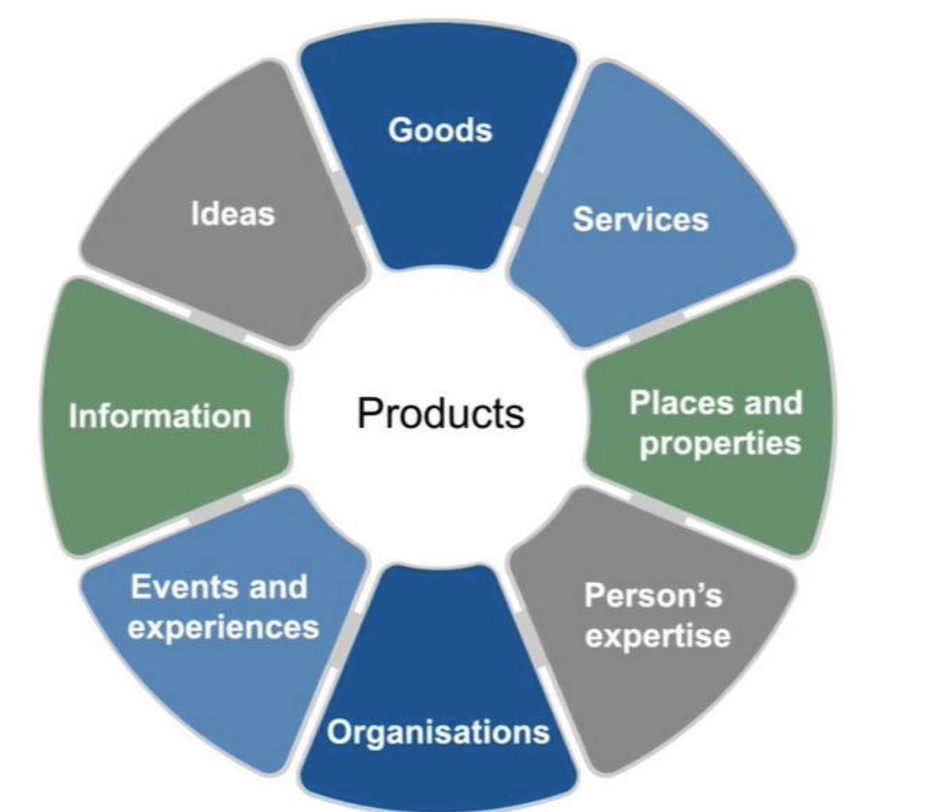
Types of Product

Slide 16
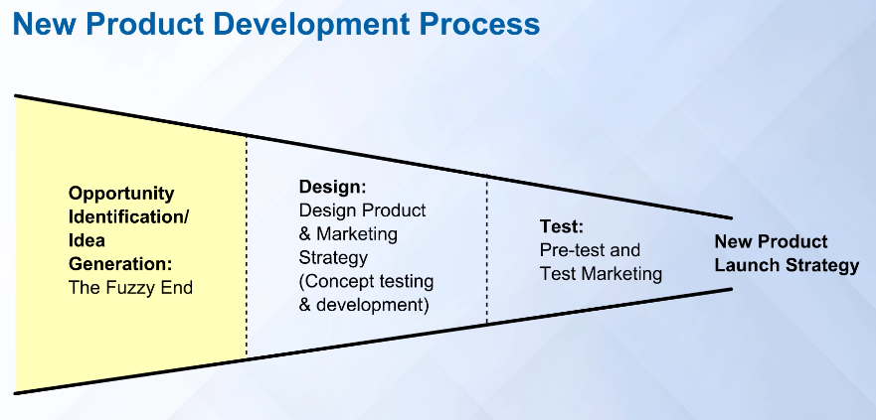
MODULE REVIEW – PRODUCT DEVELOPMENT PROCESS
Notes:
Let’s do a high level review of the development process. From the lectures we these phases:
The Fuzzy Front End
Design
Test
New Product Launch.
Taking this apart . . .

Slide 17
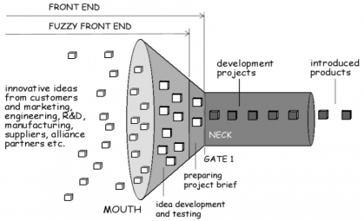
MODULE REVIEW – THE FUZZY FRONT END
Notes:
Broadly speaking, the fuzzy front end is defined as the period between when an opportunity for a new product is first considered, and when the product idea is judged ready to enter “formal” development. ... In addition, this phase is also often ill-defined and characterized by ad-hoc decision-making in many firms.
Where do these ideas come from? They can come from most anywhere. For example, it may come from the research and development department of your company. You may think about it yourself, or it may come up in a discussion you have with a friend.
It is often fuzzy because it is not fully formed yet, it is an idea or an inspiration. The challenge is sorting through these ideas and concepts to find the right one . . .

Slide 18
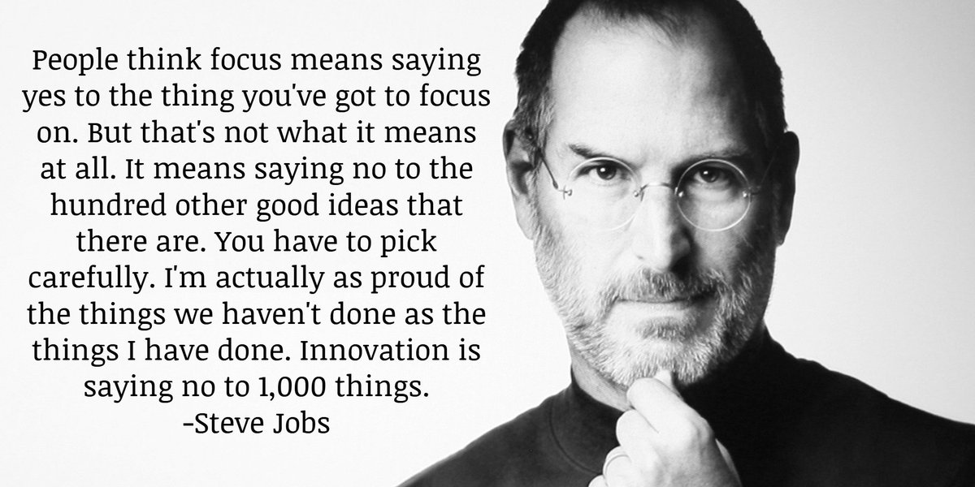
THE FUZZY FRONT END IS DIFFICULT
Notes:
The Fuzzy Front End is difficult since you have to choose among many different great alternatives. This process is quite hard. Another Apple Example, CLICK
When asked about the process of choosing what to work on Steve Jobs said
People think focus means saying yes to the thing you've got to focus on. But that's not what it means at all. It means saying no to the hundred other good ideas that there are. You have to pick carefully. I'm actually as proud of the things we haven't done as the things I have done. Innovation is saying no to 1,000 things.

Slide 19
Example: Amazon Selling partner Tools
Simple UI
Reducing Latency
Increasing Scalability for different Language
Building Analytical Insights Capability
Eliminating Error in Listing
Notes:
.

Slide 20

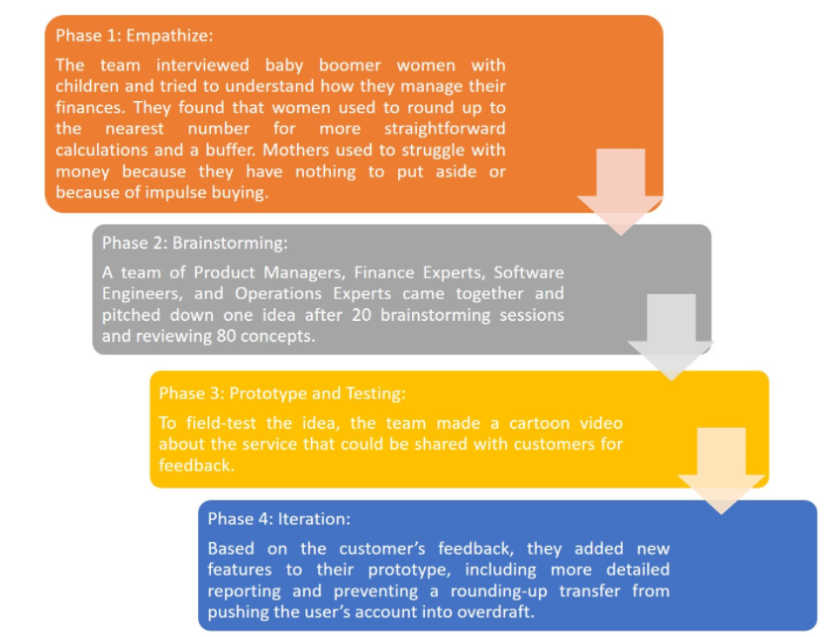
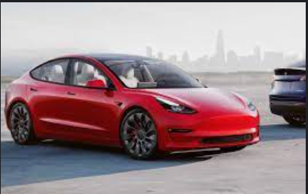
MODULE REVIEW – DESIGN THINKING EXAMPLES
Purchase Intent Testing
Tesla Model-3
In 2016, Tesla tested purchase intent by asking prospective buyers of Model-3 to put down $1000 deposit for it. Around 400,000 people did that, boosting Tesla’s confidence that their car will sell. You will find many such concept testing on kickstarter.
Notes:
In 2016, Tesla tested purchase intent by asking prospective buyers of Model-3 to put down $1000 deposit for it. Around 400,000 people did that, boosting Tesla’s confidence that their car will sell. You will find many such concept testing on kickstarter.
Bank of America – Design Thinking story → Keep the change campaign → E.g. If you bought coffee for $2.89 using “keep the change” card, the bank would deposit 11 cents into the user’s savings account. They followed the savings habit of moms who were actually managing finances at home to see how they rounded off their expenses while noting down in checkbook registers..
Look at the phases they went through.
Phase 1: Empathize:
The team interviewed baby boomer women with children and tried to understand how they manage their finances. They found that women used to round up to the nearest number for more straightforward calculations and a buffer. Mothers used to struggle with money because they have nothing to put aside or because of impulse buying.
Phase 2: Brainstorming
A team of Product Managers, Finance Experts, Software Engineers, and Operations Experts came together and pitched down one idea after 20 brainstorming sessions and reviewing 80 concepts.
Phase 3: Prototype and Testing
To field-test the idea, the team made a cartoon video about the service that could be shared with customers for feedback.
Phase 4: Iteration
Based on the customer’s feedback, they added new features to their prototype, including more detailed reporting and preventing a rounding-up transfer from pushing the user’s account into overdraft.

Slide 21
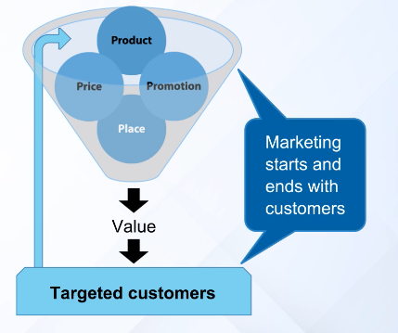
MODULE REVIEW – 4Ps of MARKETING
Notes:
Notice how Marketing starts and ends with customers. The 4Ps are about how you deliver value to your targeted customers. They are Product Place Price and Promotion.
Let me provide a bit about how to think about each of the Ps to help you generate each of the Ps.

Slide 22
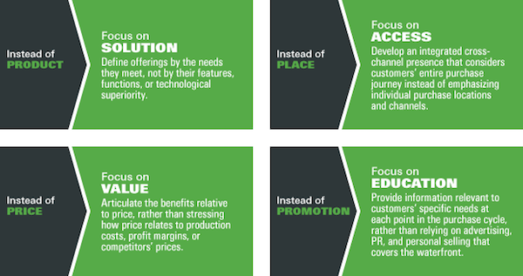
MODULE REVIEW – 4Ps of MARKETING
Notes:
The 4 Ps are a nice simple shorthand way to think about what is required.
In the digital space there is discussion about how the 4Ps are evolving. While some claim they don’t apply anymore, I disagree, I think this view helps to translate the 4Ps into how to think about eacd:
Product – Focus on Solution – Note the broader term of solution instead of product. Recall from the lectures, no one buys products, they buy solutions. For this you want to define offerings by the needs they meed, not by their features, functions, or technological superiority.
Place – Focus on Access – Consider how many things are purchased online or delivered as an online service. Here you develop an integrated cross-channel presence that considers customers entire purchase journey instead of emphasizing individual physical purchase locations and channels.
Price – Focus on Value – If you decompose a product into its components, you can determine it “cost”. However, a solution is much more than that, it is this particular collection of components that contribute to the solution for the customer. This solution has a certain value to each consumer which may be much more valuable than the associated cost of the components. You want to Articulate the benefits relative to price, rather than stressing how price relates to production costs, profit margins, or competitors prices.
Promotion – Focus on Education – Many people in the market know how often they are seeing mass market ads. While often still necessary to build general awareness, it is important to better target particular customers with messages that educate. We want to provide information that is relevant to customers’ specific needs at each point in the purchase cycle, rather than relying on advertising, public relations and personal selling.
We’ll touch on this a bit more in the next module when we discuss customer personas.

Slide 23
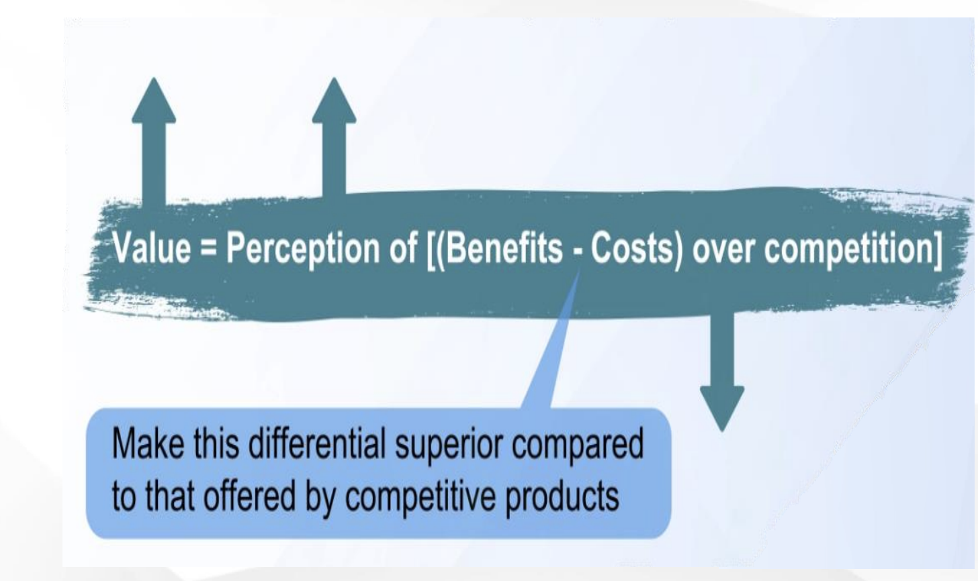
Value for Customers

Slide 24
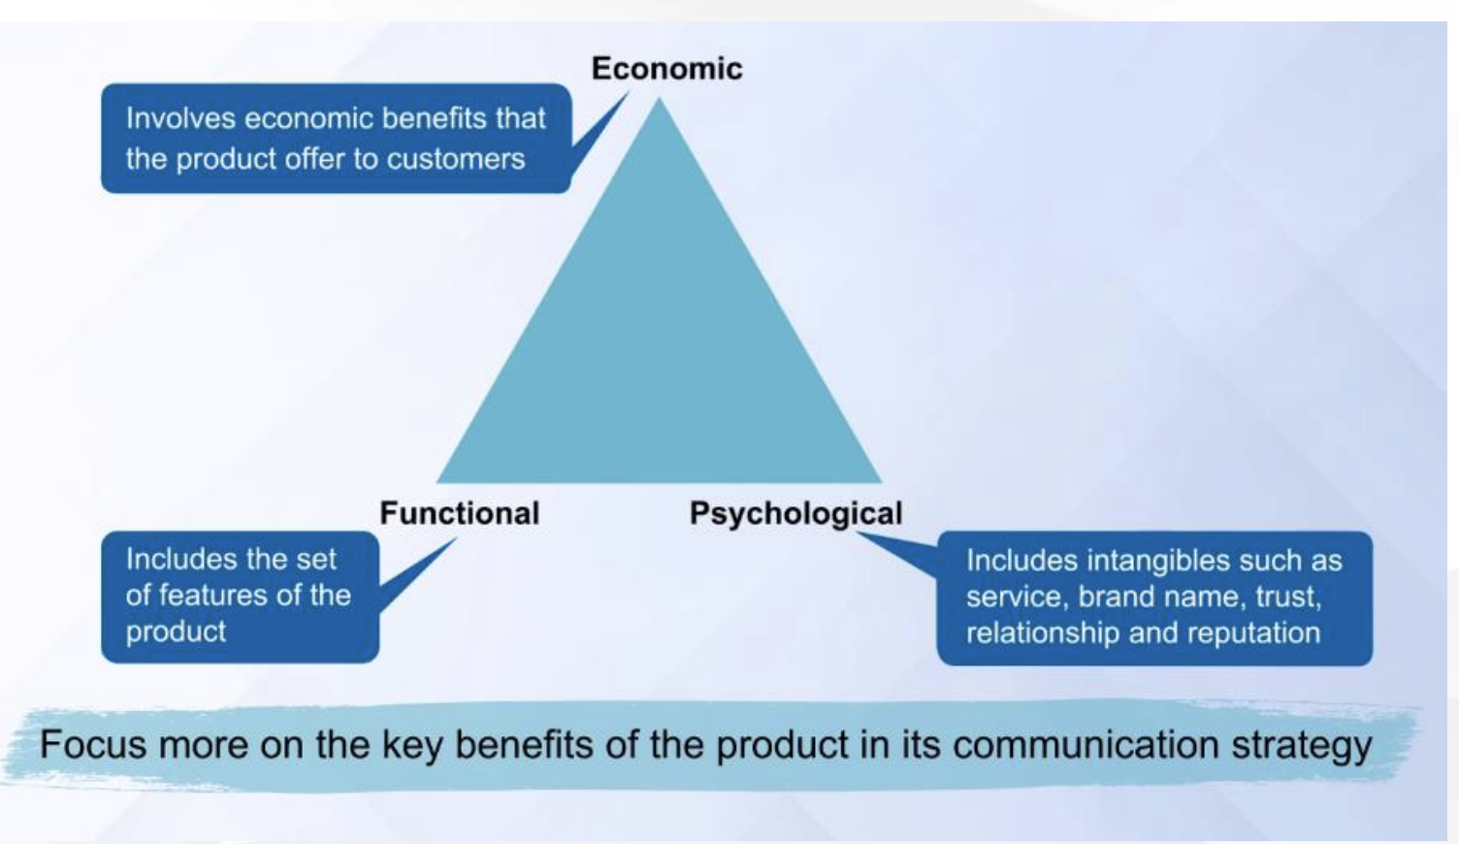
Value for Customers

Slide 25

Brand Positioning

Slide 26

Case
How Domino’s Become the World’s Biggest Pizza Chain after 2009 PR Crisis

Slide 27

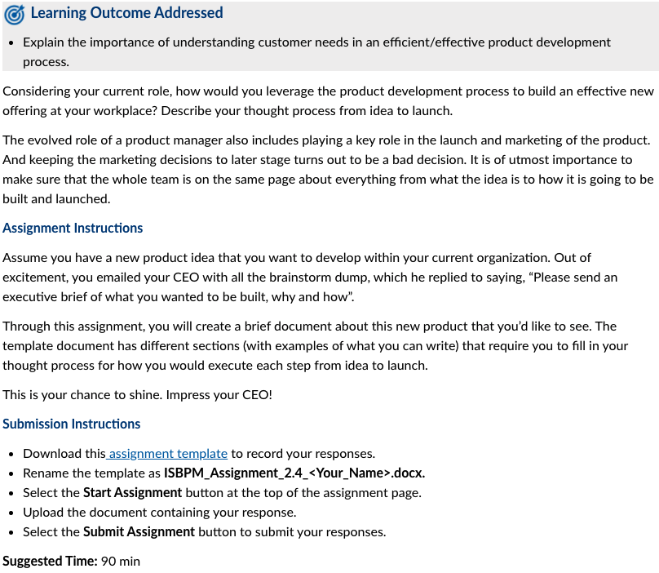
ASSIGNMENT 2.4 PROBLEM
Notes:
To help you get used to the assignments, let’s focus for a moment on the Assignment instructions
Assume you have a new product idea that you want to develop within your current organization. Out of excitement, you emailed your CEO with all the brainstorm dump, which he replied to saying, “Please send an executive brief of what you wanted to be built, why and how”.
Through this assignment, you will create a brief document about this new product that you’d like to see. The template document has different sections (with examples of what you can write) that require you to fill in your thought process for how you would execute each step from idea to launch.

Slide 28
ASSIGNMENT 2.4 SUBMISSION
Notes:
To help you get used to the assignments, let’s focus for a moment on the submission instructions:
CLICK
Submission Instructions
Download this assignment template to record your responses.
Rename the template as ISBPM_Assignment_2.4_<Your_Name>.docx.
Select the Start Assignment button at the top of the assignment page.
Upload the document containing your response.
Select the Submit Assignment button to submit your responses.
CLICK
The suggested amount of time it should take you is about 90 minutes.
Now for the actual assignment.

Slide 29
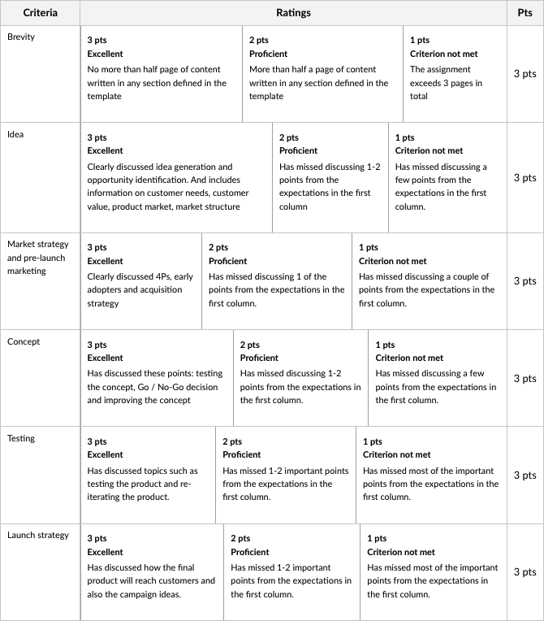
ASSIGNMENT 2.4 RUBRIC
Notes:
The document is looking for 6 things, each worth the same amount, 3 points each, for a total of 18 points.
We’ll use each of these as the topics for discussion

Slide 30
QUESTIONS FROM IN-BOX
Length of the assignment:
If I understand it correctly, the total length of the assignment including all sections doesn't exceed 3 pages! Am I correct?
Notes:
While the submission needs to be short, that does not mean it is not a lot of work. While it sounds contradictory, we are looking for detail in a short format. Distill the information down to the critical items that connect with the viewer/project funder. Consider the original Twitter, you had to find a way to communicate in 140 characters. What can you say that is impactful . . . Concisely. Using the iPod example from the last office hours. Consider two ways to describe the product: A music player with a click-wheel for navigation, 1GB disk drive, a 2"x1" monochrome display and a battery that enable you to listen for 4 hours of recordings. vs 1000 songs in your pocket Often you will not have a long period of time or format to provide a lot of detail. You need to craft a message that is short and to the point. There are 6 items in the Rubric, the first being Brevity. Brevity Idea Market strategy and pre-launch marketing Concept Testing Launch strategy
That would mean 3 pages or less., Do this while satisfying each of the items required in the rubric.

Slide 31
QUESTIONS FROM IN-BOX
Can someone provide more details on what Concept Testing is all about?
How do we validate product design and marketing strategy?
Notes:
Work on this
I think it is that you have a concept you want to test the concept with the target segment to ensure that is solves a problem. As professor Sidharrth mentioned in the videos, customers do not purchase products, the purchase solutions. This is the testing about whether the solution, embodied by the product, solves the customer problem AND the value of that solution to the customer.
Consider the example of the milk shake that professor Sidharttha discussed in the video. Not how there were two types of buyers with slightly different requirements, how they redefined the product to address each.
This is what we referred to in slide 11.
Concept testing helps to ensure that the product meets the intended business goal. It includes clearly defined KPIs to understand performance of your product in the market. It could also include aspects of having a control group to ensure that your results aren't skewed. Will wait for others to chime in as well.

Slide 32
QUESTIONS FROM IN-BOX
Is it mandatory to have a novel ideal that is yet to hit the market? Can we take feature addition to an existing product ?
In case I don’t have an idea for my current company , can I have an Idea for any other company such as Apple , Uber or Amazon?
Notes:
Often product ideas are quite simple. Consider the fuzzy front end, there can be lots of different inputs to the process. By adding a feature, are you creating a new product? If so how?
Do the 4Ps change? Can you charge a premium for that feature packaged into the product? There are lots of questions to answer. So, yes, it can be a feature though you need to put a lot of thought into it.
And for the second part of the question:
In case I don’t have an idea for my current company , can I have an Idea for any other company such as Apple , Uber or Amazon?
Sure, that it is a great thought exercise.

Slide 33
QUESTIONS FROM IN-BOX
Are there different ways to conduct market research for B2B and B2C products?
Apart from marketing research, in what ways do the B2B and B2C product development process differ?
Notes:
Ankur provided a very good answer to this question:
While the actual development process remains the same, the strategies to evaluate value and the influencers in the ecosystem changes.
- In B2B the buyers are not the users - The sales cycle is typically longer than B2C - MVPs usually do not work or yield expected results in case of B2B - Decision making is rather complex in B2B, due to there being more influencers.
We will continue to cover the differences from week to week as the course progresses.

Slide 34
NEXT WEEK
Programme Learning Outcomes Addressed:
Analyse strategies and frameworks for developing and marketing a new product.
Define the problem a product will solve while mapping the customer’s persona and journey.
By the end of this week, you will be able to:
Understand markets and define them.
Explain market segmentation and targeting.
Describe a customer or user persona.
Define and illustrate customer journey.
Notes:
In it we will cover:
CLICK
Programme Learning Outcomes Addressed:
Analyse strategies and frameworks for developing and marketing a new product.
Define the problem a product will solve while mapping the customer’s persona and journey.
By the end of this week, you will be able to:
Understand markets and define them.
Explain market segmentation and targeting.
Describe a customer or user persona.
Define and illustrate customer journey.

Slide 35
Assignment
Brevity
Idea
Concept
Market Strategy & Pre-Launch Marketing
Testing
Launch Strategy
Idea generation and opportunity identification
Fundamental concepts for new product success
Customer needs, customer value, product market, market structure
How would you test your product concept?
Go / no-go decisions
Improve the concept
4Ps
Who would be your early adopters and how would you acquire them?
How would you test the product?
Reiterate
How will the final product reach the customers?
Any campaign you would like to run for effective branding and acquisition?

Slide 36
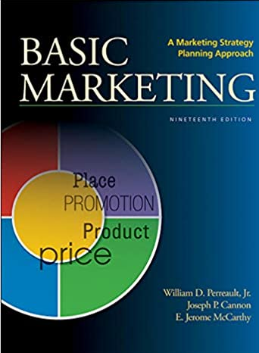
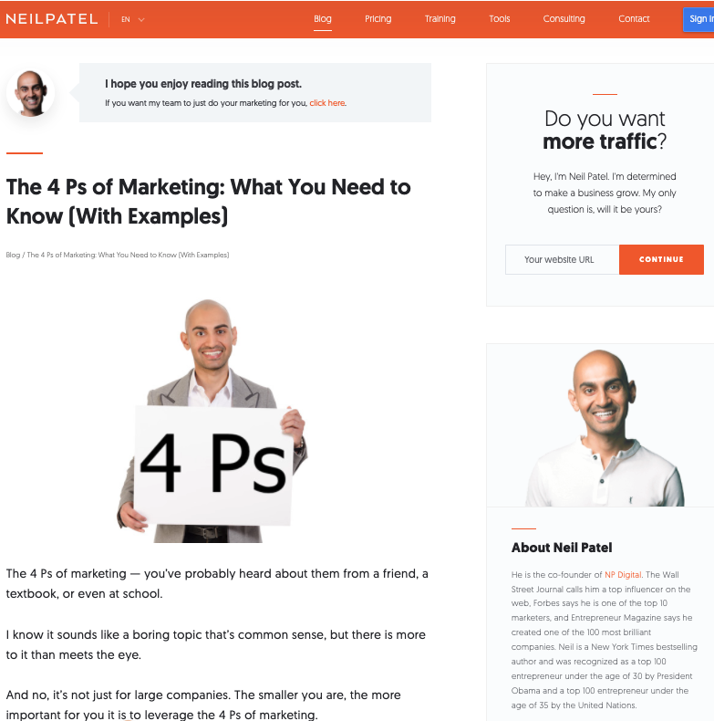
ADDITIONAL RESOURCES
Notes:
Here are a few resources. CLICK
The 4Ps come from a book by Jerome McCarthy, now in its 19th Edition. This book pioneered the four Ps. The unifying focus of Basic Marketing has always been on how to make marketing decisions, deciding what customers to focus on and how best to meet their needs.
https://amzn.to/33leyo9
Neil Patel has a great blog on marketing. Perhaps a good place to start is his article on the 4Ps.
https://neilpatel.com/blog/
https://neilpatel.com/blog/4-ps-of-marketing/

Slide 37
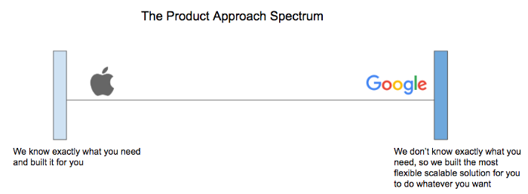
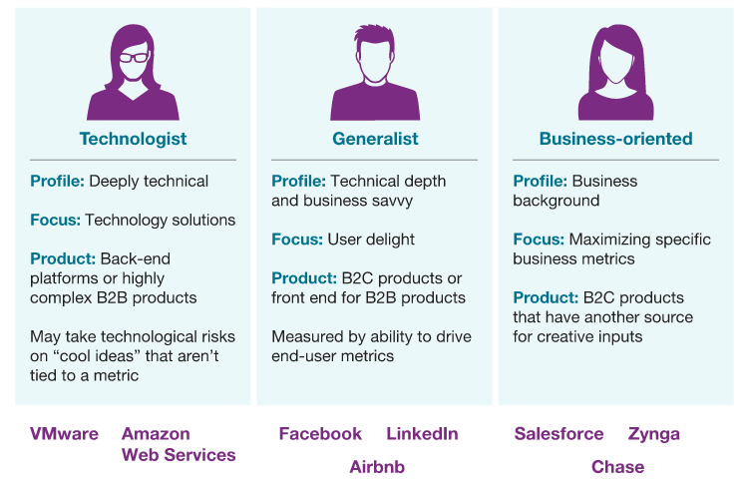
ADDITIONAL RESOURCES
Notes:
For additional resources I want to continue to point you to your classmates. They are often a great resource and can provide a different perspective.
Here are a couple of great resources from students we have had.
CLICK
Are you an Apple-like or Google-like Product Manager? Basically, the Apple side of the scale, they know what you need. On the Google side, they don’t know so they build a product that is flexible and configurable to most anything you want.
Steve Jobs is famous for saying, “A lot of times people don’t know what they want until you show it to them ”
https://medium.com/@roilavan/are-you-an-apple-like-or-google-like-product-manager-4628c8db69c4
And another article CLICK
Product managers for the digital world where they lay out some of the different types of focus, from Technologist to Generalist to Business Oriented. Different products and companies have somewhat different types.
The key takeaway is that there is a spectrum of how product management is done. You need to find what is right for your market, customer and, perhaps as important, the skill set of the people on the team.
https://www.mckinsey.com/industries/technology-media-and-telecommunications/our-insights/product-managers-for-the-digital-world

Slide 38
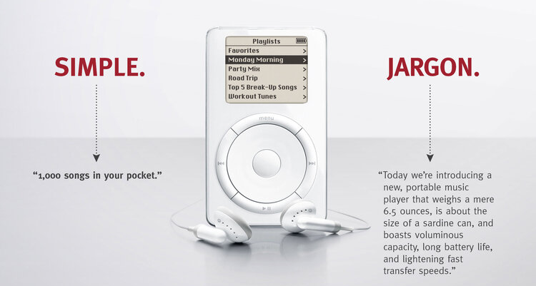
ADDITIONAL RESOURCES
Notes:
A bit more about Brevity. Using the iPod as an example here is a graphic that communicates Brevity.
Note how customer focused this simple message is. While technical people can get caught up in the jargon, they communicated the value of the iPod in a simple statement, 1000 songs in your pocket. Who wouldn’t want that? Again, lots of standard components packaged in a unique way.
Now for Next Week . . .

Slide 39
Additional Resource – Lean Canvas
Problem
What is the problem that your early adopters are facing?
Solution
Details of your solution
Unique Value Proposition
What is the value that you are offering?
Unfair Advantage
Something unique that cannot be copied
Customer Segment
Talk about the customer segment you want to target
Existing Alternatives
How are they solving it today?
Key Metrics
How to measure if you are succeeding
Channels
How will you find your early adopters, sell to them and service them
Early Adopters
Who would be your early adopters?
Cost Structure
What it will cost you
Revenue Streams
How you will make money
Read More - https://www.pragmaticcoders.com/blog/how-to-use-lean-canvas

Slide 40
Additional Reading
Product development process: The 6 stages (with examples)
7 Successful Product Development Examples
8 Examples of How Latent Needs Can Deliver Practical Innovation
Customer Value Explained

Slide 41
NEXT WEEK
Programme Learning Outcomes Addressed:
Analyse strategies and frameworks for developing and marketing a new product.
Define the problem a product will solve while mapping the customer’s persona and journey.
By the end of this week, you will be able to:
Understand markets and define them.
Explain market segmentation and targeting.
Describe a customer or user persona.
Define and illustrate customer journey.
Notes:
In it we will cover:
CLICK
Programme Learning Outcomes Addressed:
Analyse strategies and frameworks for developing and marketing a new product.
Define the problem a product will solve while mapping the customer’s persona and journey.
By the end of this week, you will be able to:
Understand markets and define them.
Explain market segmentation and targeting.
Describe a customer or user persona.
Define and illustrate customer journey.

Slide 42

Over to you!

